Slide 1


Data Science for Agent-Based Transport Simulations
Hello! We’ll be starting soon.
Today we will be discussing:
joining tables and
the mid-semester assignment.
WiSe 20/21
William (Billy) Charlton charlton@vsp.tu-berlin.de
Scientific Researcher Transport Systems Planning and Transport Telematics Technische Universität Berlin

Slide 2
Relational data: Joining tables together
It’s rare that a data analysis involves only a single table of data.
Typically you have many tables of data, and you must combine them to answer the questions that you’re interested in.
Collectively, multiple tables of data are called relational data because it is the relations, not just the individual datasets, that are important.

Slide 3
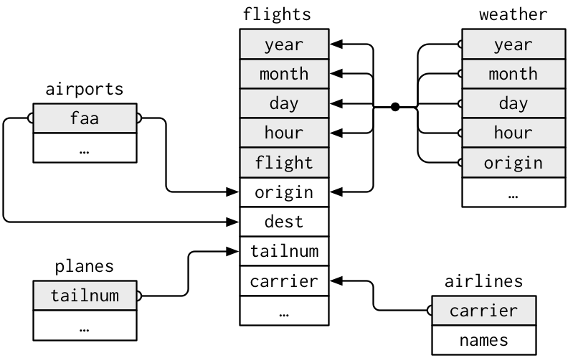
library(nycflights13)

Slide 4
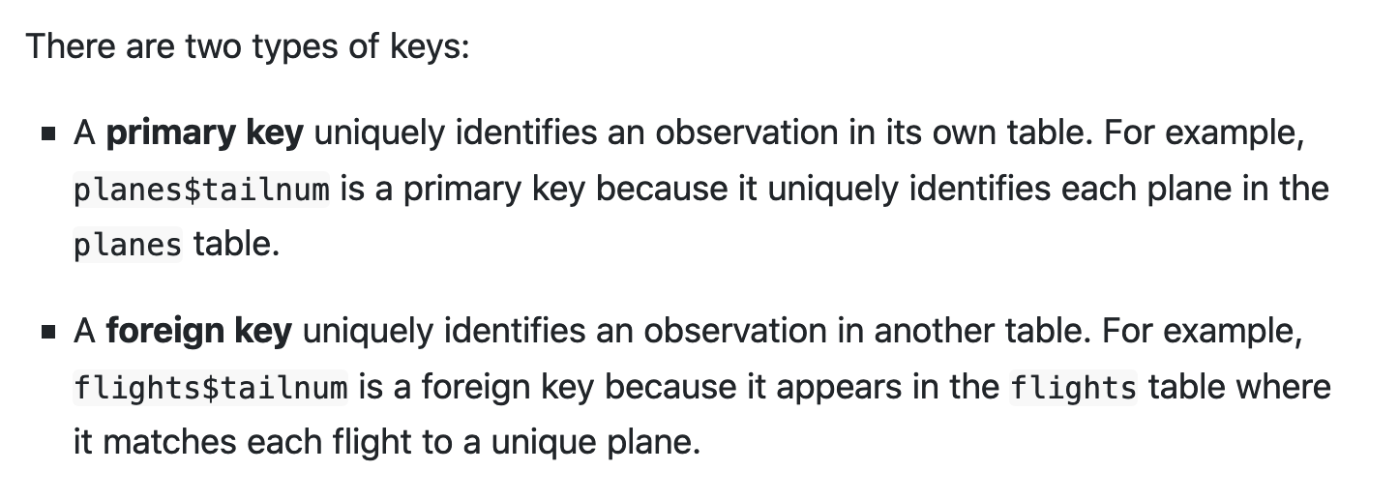
Join tables using KEY variables – the unique link between them.

Slide 5
mutating joins: match using keys, then copy variables
when joining tables tables x and y:
left_join: keep all rows in x
right_join: keep all rows in y
inner_join: only keep rows that are in both x and y
full_join: keep all observations that are in either x or y

Slide 6
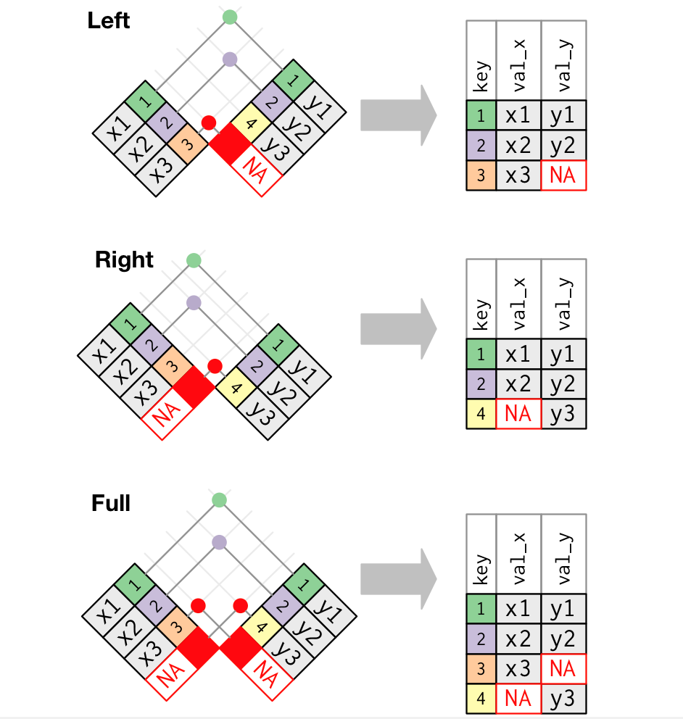
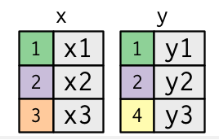
Maybe this graphic will help?

Slide 7
mutating joins: match using keys, then copy variables
when joining tables tables x and y:
left_join: keep all rows in x
right_join: keep all rows in y
inner_join: keep rows that are in both x and y
full_join: keep all rows that are in either x or y

Slide 8
filtering joins: match using keys, then drop some rows
when joining tables tables x and y:
semi_join: keep all rows in x that have a match in y
anti_join: drop all rows in x that have a match in y
→ semi_join is useful for filtering on multiple variables
→ anti_join is useful for debugging join mismatches ☺

Slide 9
Exercise 6-1

Slide 10
Quickstart: Shapefiles and maps using sf and tmap
sf: “simple features” – a geographic data format
tmap: a tiny interactive map library
install.packages(c(‘sf’, ’tmap’))
berlin <- st_read('week06/berlin-bezirke/bezirke_berlin.shp')
tm_shape(berlin)
+ tm_borders()
)

